Slide 1
Data Science
-Numpy, Pandas, Matplotlib

Slide 2

Recap

Slide 3
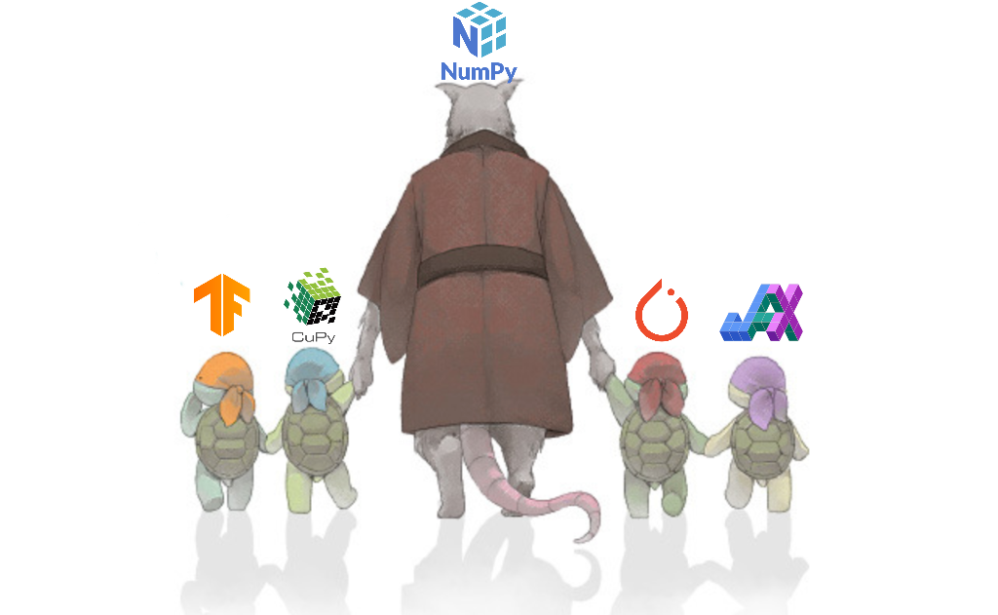
Numpy
Travis Oliphant
-was implemented in C

Slide 4
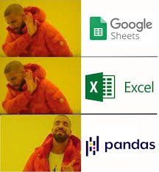
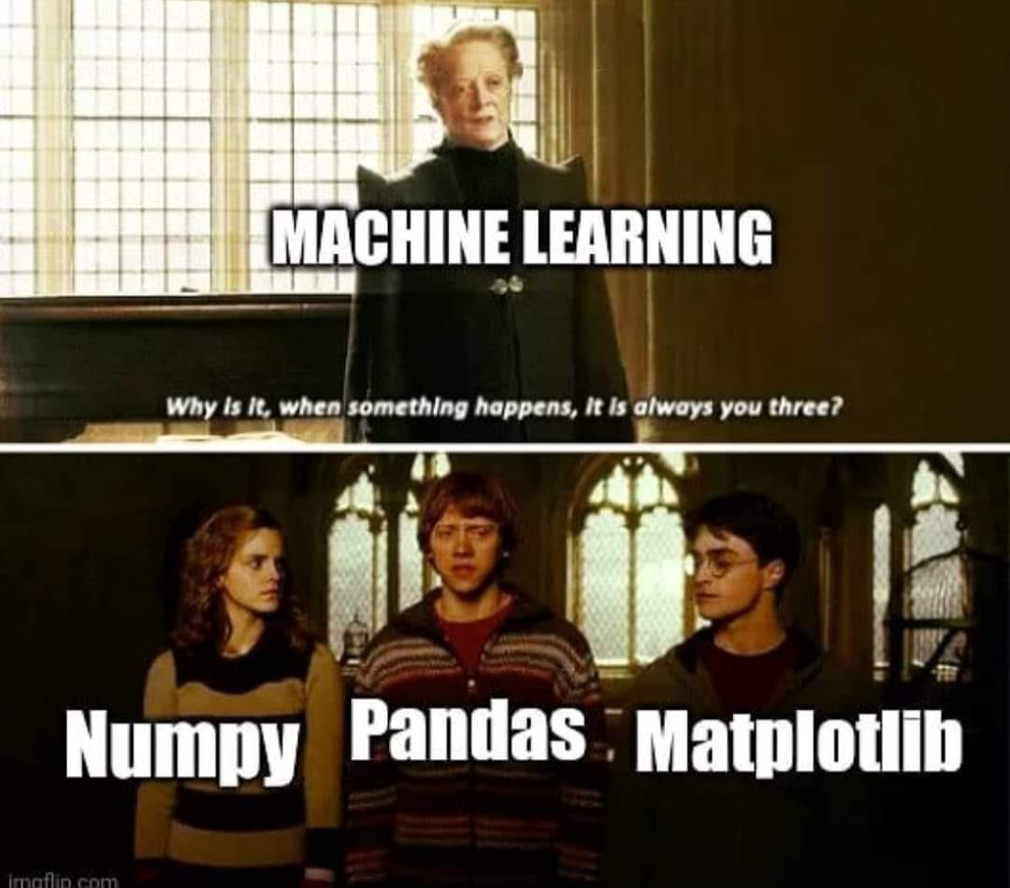
Why do we need it?
Can work in huge datasets
Faster for multidimensional array

Slide 5
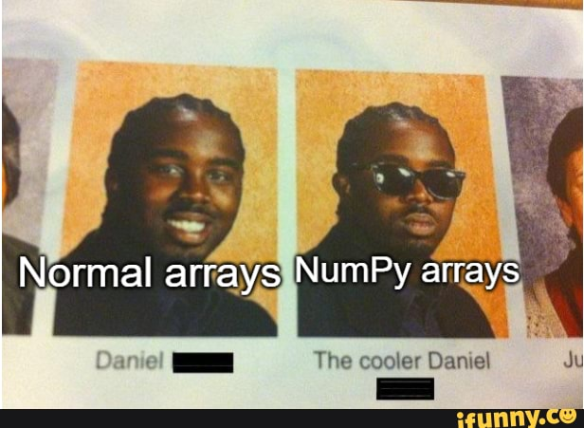
Numpy Arrays
-list
-np.zeros()
-np.ones()
-np.random.randint()

Slide 6

Reshaping
np.reshape()

Slide 7

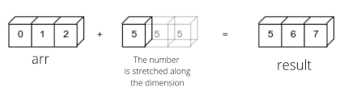
Broadcasting
-stretching of the number along the dimension
-when two shapes are incompatible

Slide 8
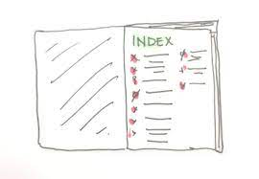

Slicing & Indexing
Arr[0]
Arr[:]
arr[:-1]

Slide 9
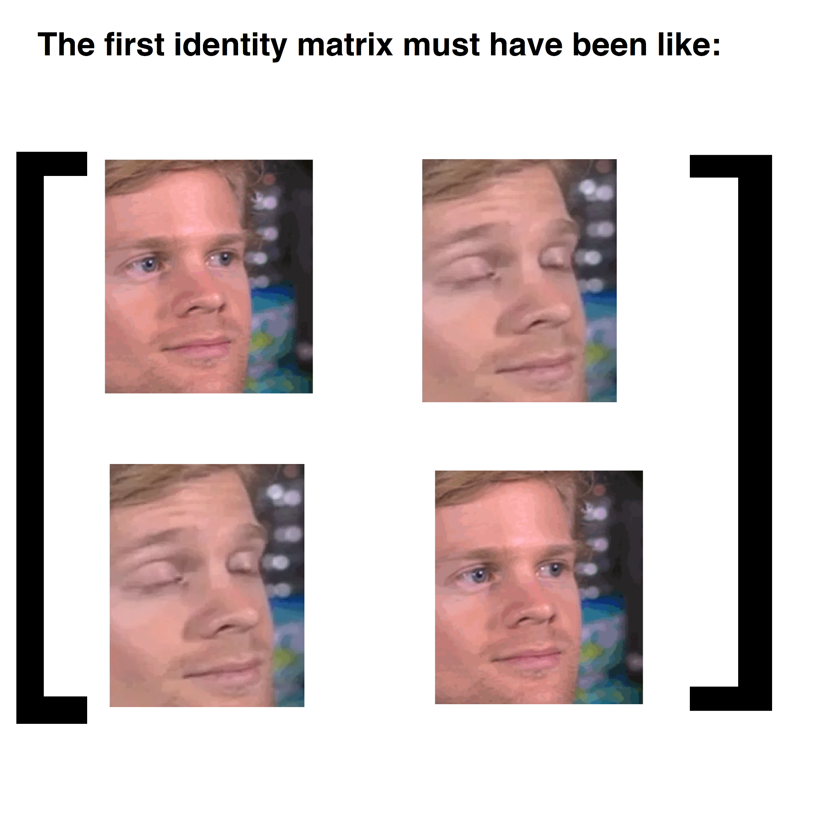
Identity Matrix
-np.eye()
-np.identity()

Slide 10
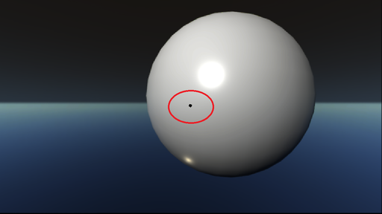
nan
np.nan()
When dividing 0 with 0

Slide 11

Make sure you code along

Slide 12

Pandas
Pandas is derived from “panel data”

Slide 13


Why do we need it?
pandas is often used in tandem with numerical computing tools like NumPy and SciPy
Equipped with a set of mathematical and statistical tools

Slide 14
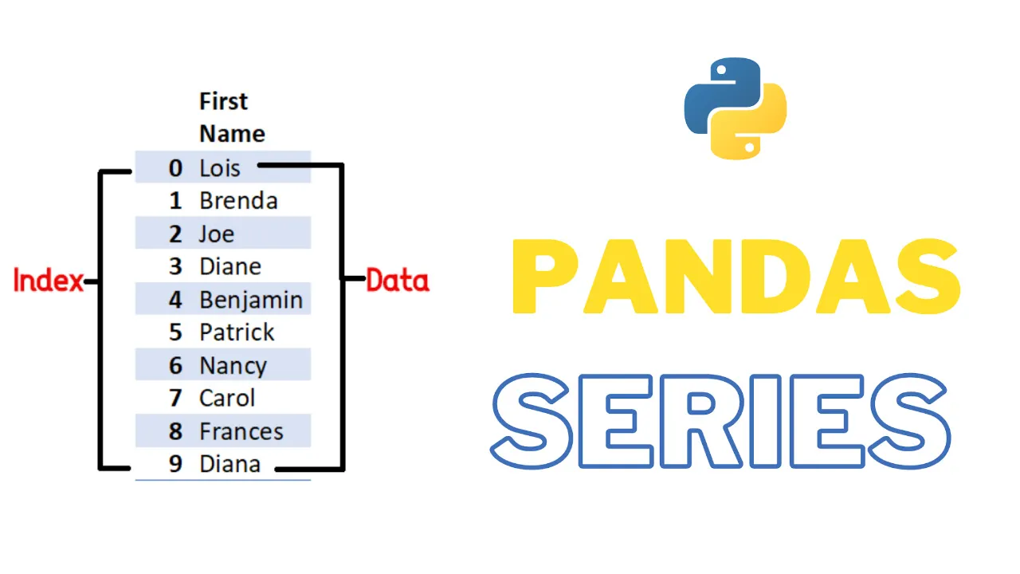
Functionalities
SERIES CONSTRUCTION

Slide 15
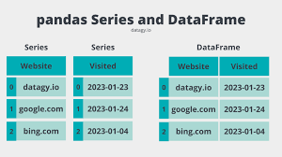
Functionalities
DATAFRAME

Slide 16
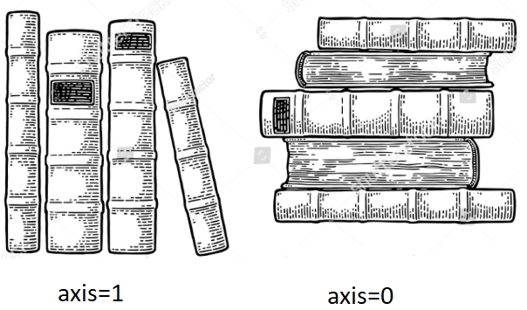
Functionalities
REINDEXING

Slide 17

Functionalities
DROPPING ENTRIES

Slide 18
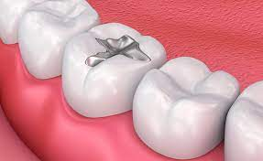
Functionalities
FILLING nan

Slide 19

Functionalities
df.head()
df.describe()

Slide 20
Pandas

Slide 21

Task from yesterday

Slide 22
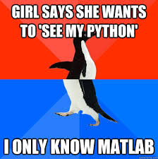
Matplotlib
Why did Matplotlib break up with Python?
Because it just couldn't get over its ex, Matlab.

Slide 23
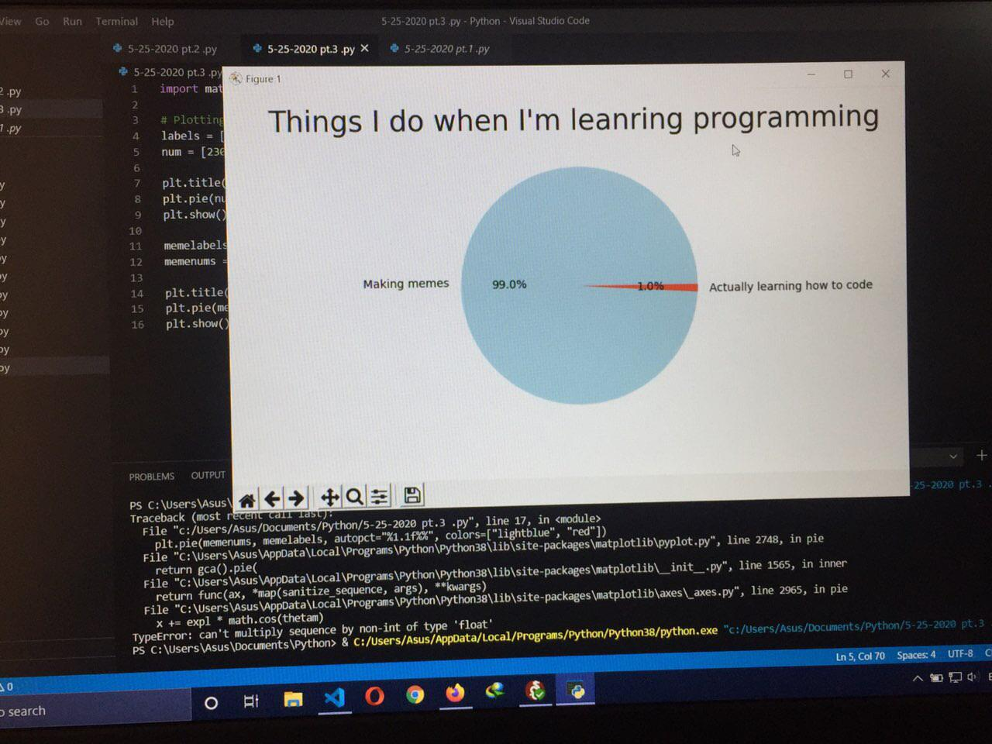
Why do we need it?
Matplotlib is a comprehensive library
A picture is worth a thousand words

Slide 24
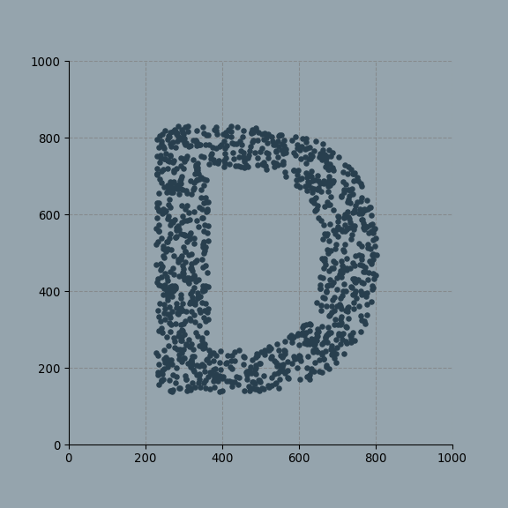
Functionalities
Data Visualization

Slide 25
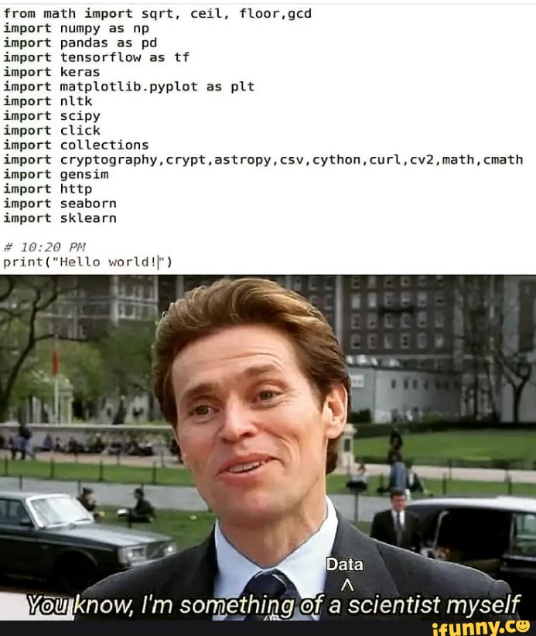
Functionalities
-Plotting
-labeling

Slide 26

Functionalities
Easy to comply with another libraries

Slide 27

Functionalities
Object Oriented

Slide 28
Training a machine on a huge dataset
ML is a subset of AI where you train data to machines, it processes and act accordingly.
Value Prediction
Introduction to ML
to make machine do work without actually giving guidelines , by giving them training data.

Slide 29
A deviation from the traditional programming approach (where each step in the concerned process is to be programmed explicitly). Here, machines are “taught” to emulate human decisions and recognize patterns in data with the help of various machine learning algorithms.
Machine learning
…..
Introduction to ML
Type of AI

Slide 30
Grades of 5 students and any three subjects
Find total, average, pass/fail, grade of each students using functions, OOP
Using Numpy array ( find who scored highest, no. of students scoring highest in maths

